Slide 1
Casanova 2.0 Game scripting language
Mohamed Abbadi
Ph.D. student
Tilburg University, Ca’Foscari University

Slide 2
My research
Computer languages
Design
Runtime
Verification
Usability
Application domain: games

Slide 3
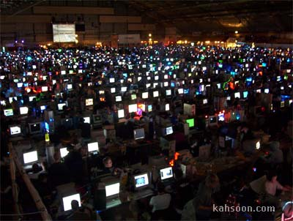
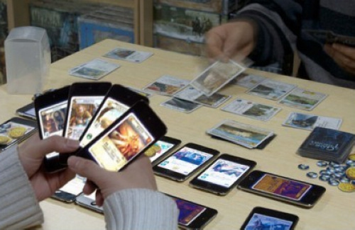

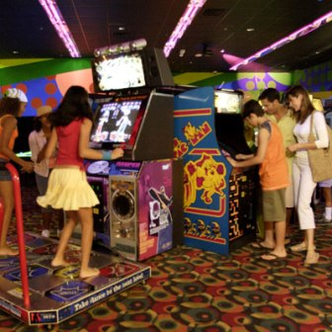
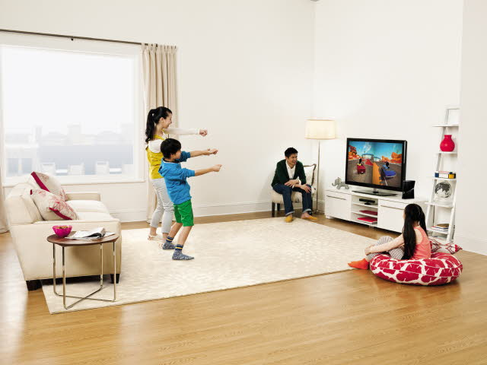
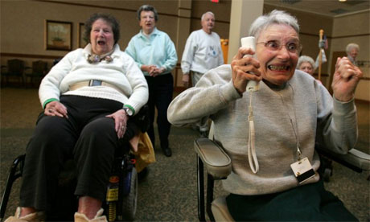
Videogames everywhere

Slide 4
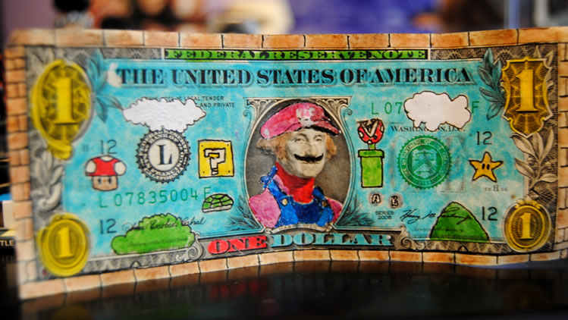
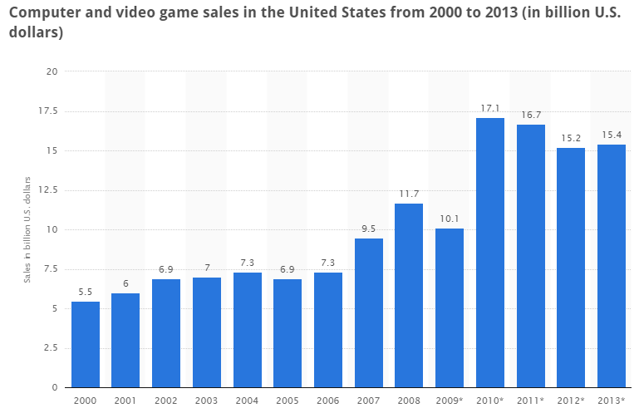
Games nowaday

Slide 5
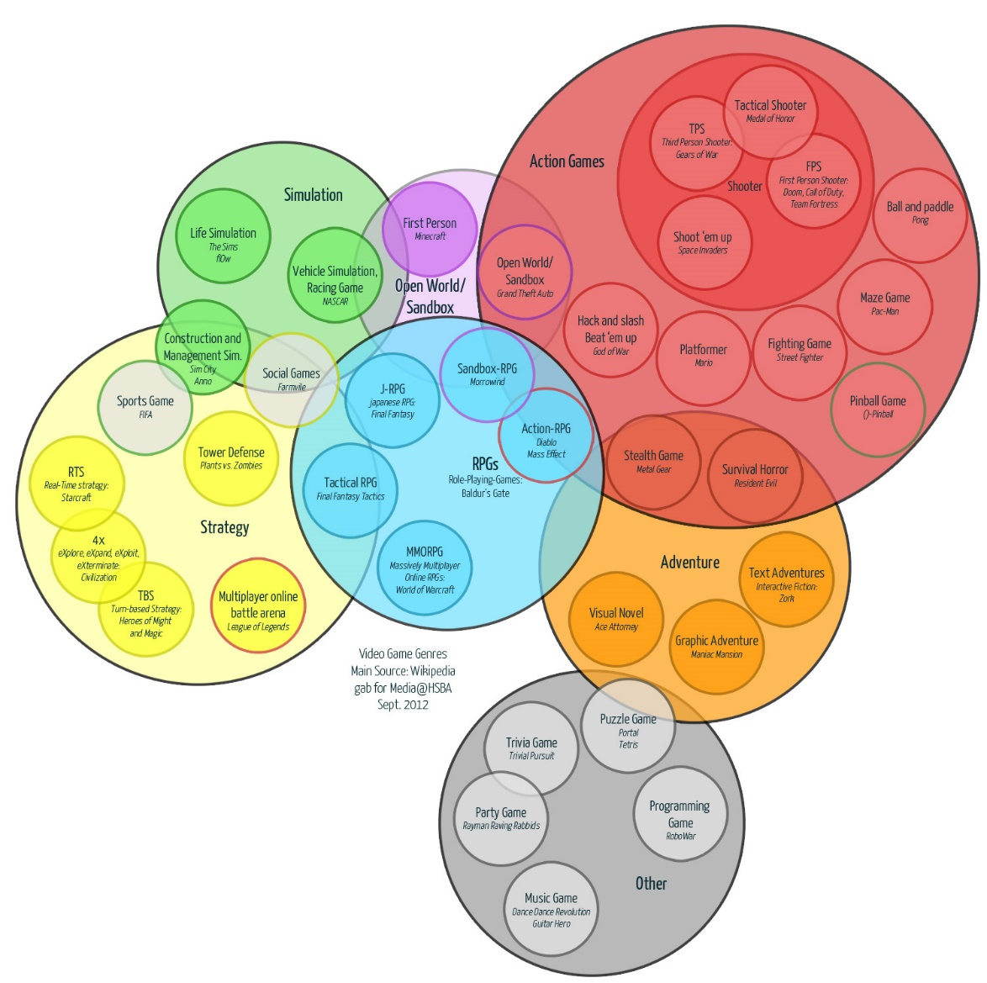
A LOT of game genres

Slide 6
Only for entertaining?
Games are also used in many different scenarios, not only for entertaining people
Serious games

Slide 7
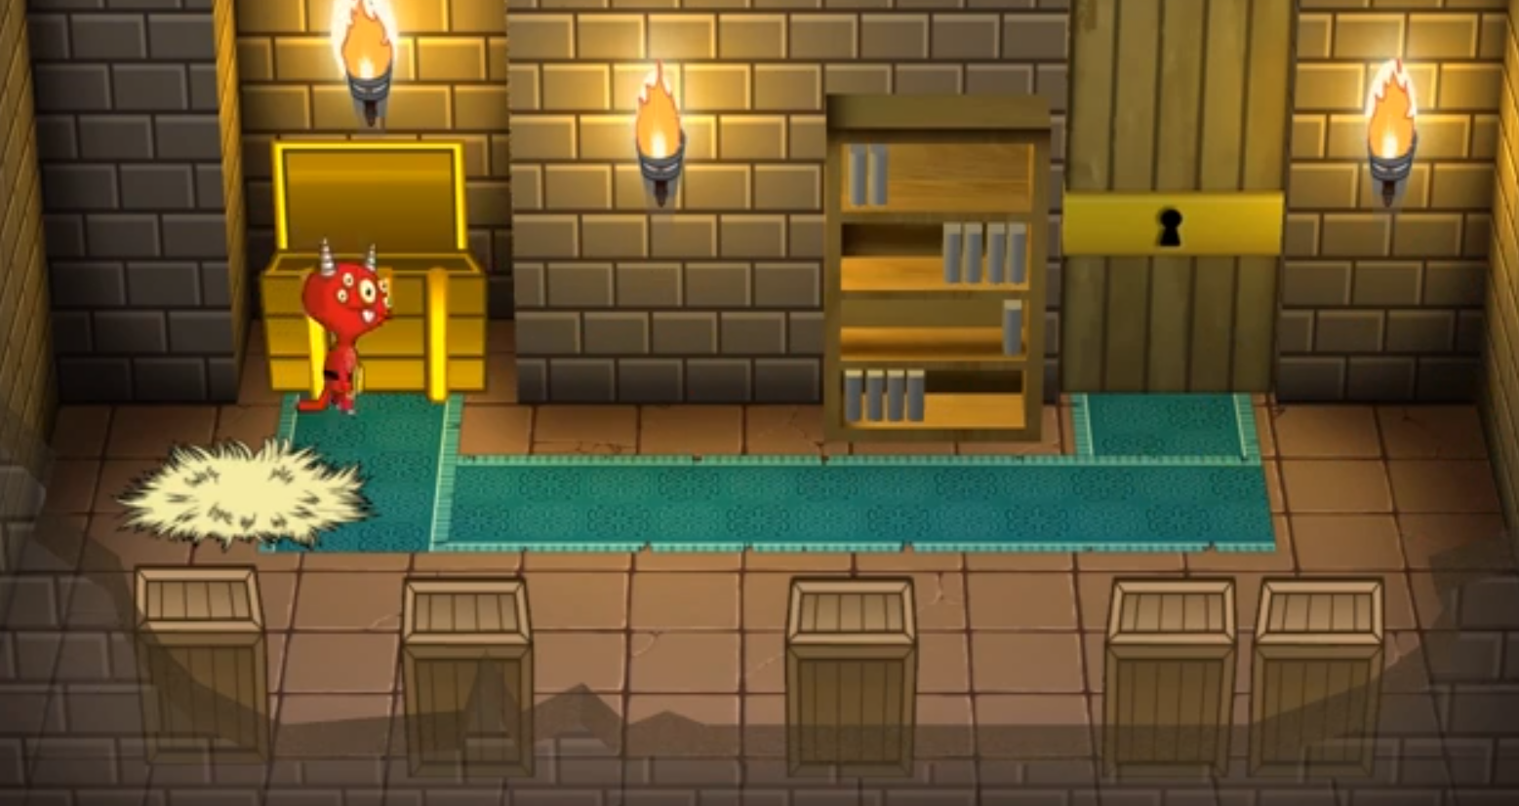
Exploration games
Necessary evil
http://evil.gua-le-ni.com/

Slide 8
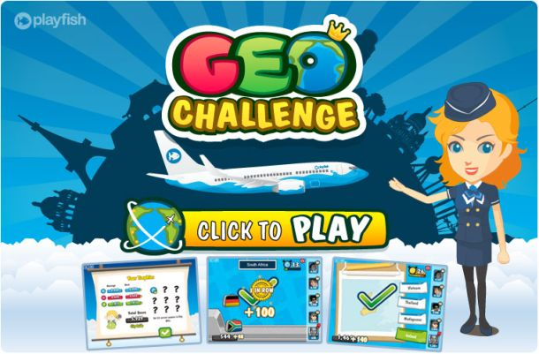
Edutainment games
World challenge
http://playfish.com/

Slide 9
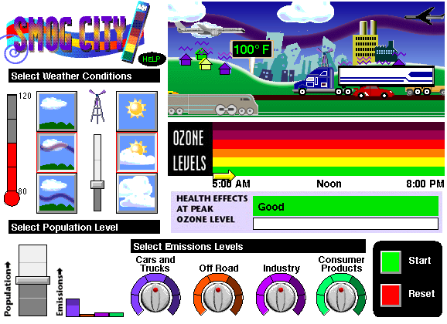
Awareness games
Smog city
http://www.smogcity2.com/

Slide 10
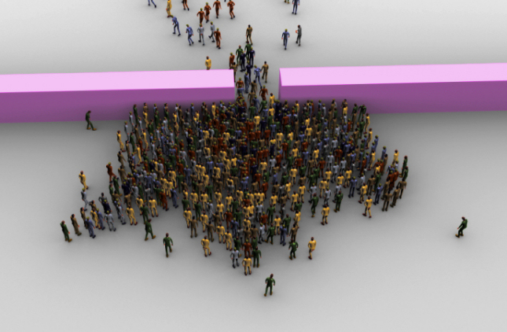
Research games
Emergency egress and evacuation
http://www.geosimulation.org/disasters.html

Slide 11
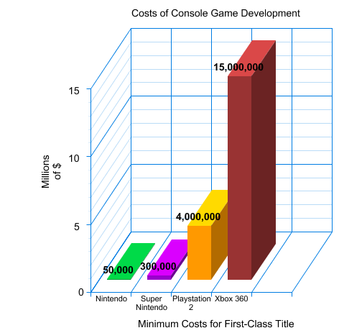
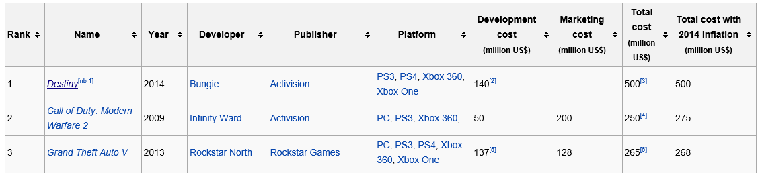
Games are expensive
Design
Tool
Maintenance
Content
Etc.
Serious games are less expensive, but suffer the same problems present in commercial games (main difference is on budget)

Slide 12
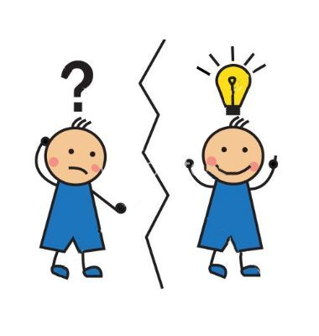
My research
Focuses on:
Design (development phase), i.e. giving tools to researchers to easily express their ideas
With a special attention on:
Tools
Maintenance

Slide 13
Casanova
Domain specific language for games
Not bounded to specific genres
Designed to help researchers, and serious game developers in general, to better achieve innovation
Reduce effort for developing games, thus helping researchers with few resources
A very easy learning curve
Not for AAA games (commercial games)

Slide 14
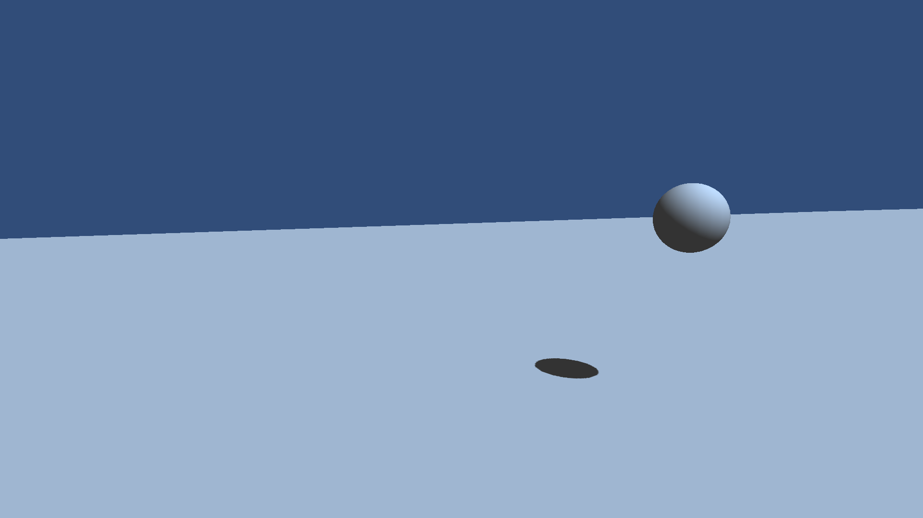
A Casanova game – bouncing ball

Slide 15
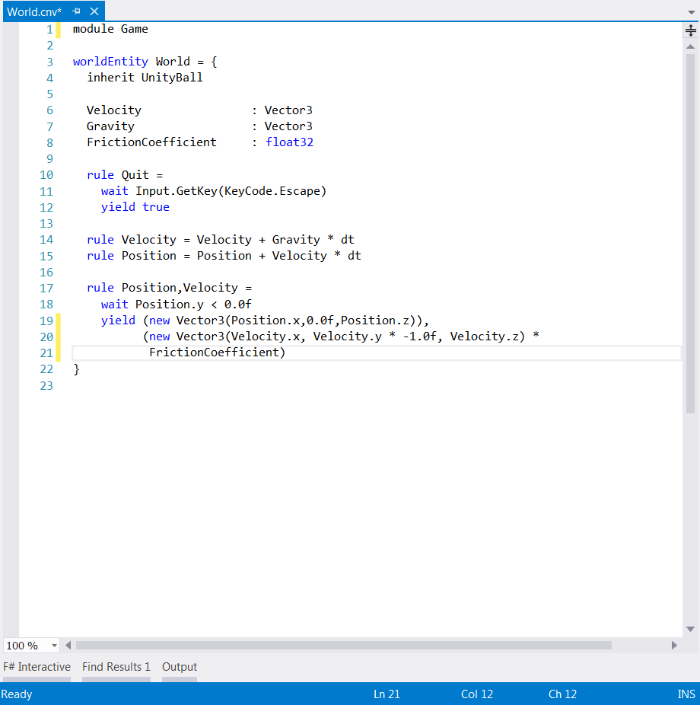
Casanova code – brief

Slide 16
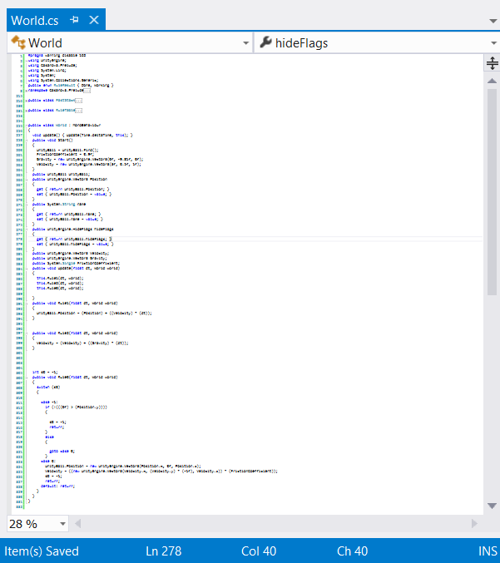
Very simple?
Casanova
C#

Slide 17

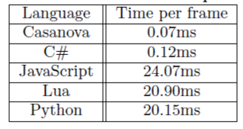
Not only code length!
Casanova is very performant

Slide 18
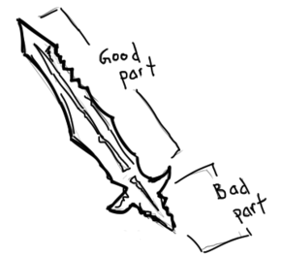
Easy to use?
Usability study is part of my ongoing research
Asses the ease of use of Casanova
Usability test compared with other computer languages
Tests with group of students
Perfect the quality of our environment
Possibly to adapt/introduce new features

Slide 19
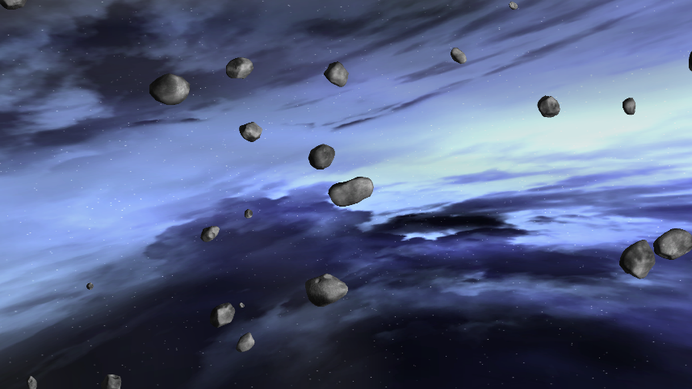
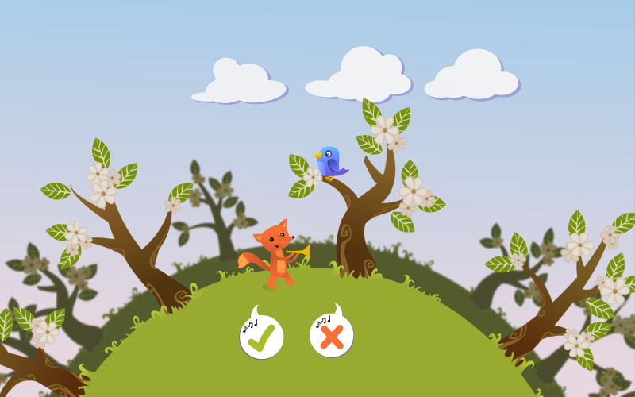
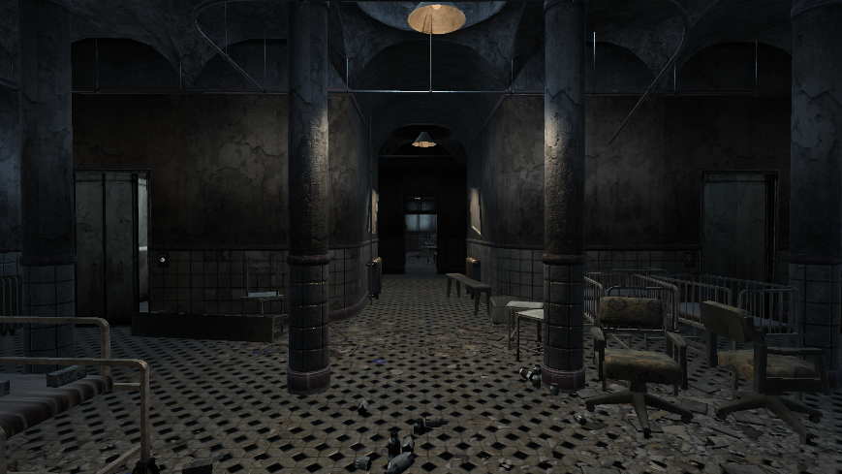
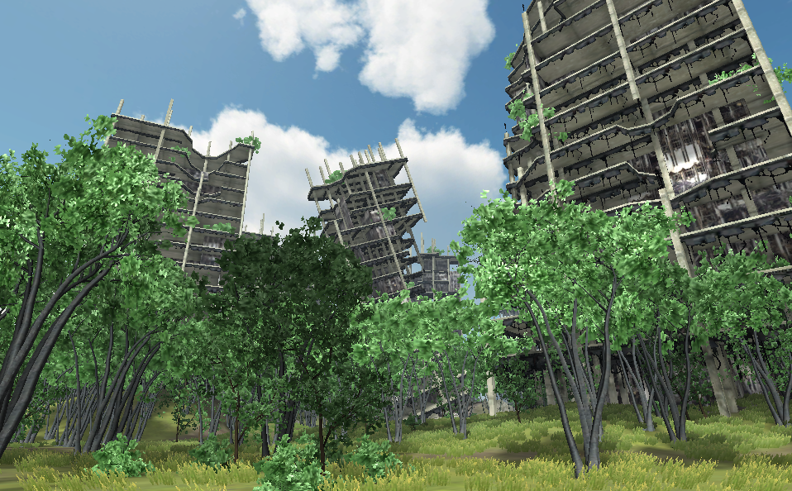
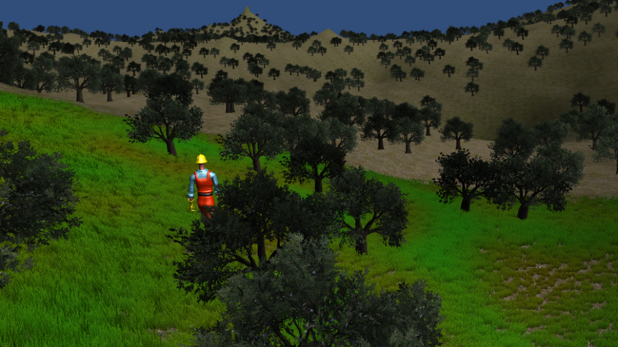
Some Casanova games
All sample are available on: http://casanova.codeplex.com/

Slide 20
Case study here in Tilburg

Slide 21
A game for dyslexia detection in children
Pairs of sounds; say if equal or different
Children get bored really quickly

Slide 22
A game for dyslexia detection in children
Idea: create a frame of game mechanics around this concept
More pleasant environment to perform the tests
Very simple mechanics
Use animations and visual metaphors to explain the tasks

Slide 23
Dyslexia game - demo

Slide 24
Conclusion
Game development is interesting for research and other novel applications
Huge costs make the realization of this infeasible for most practical realities
We propose a novel language built for fast development of games
We aim at using this language to speed-up development of research games for third parties
While building case studies we wish to
Perfect the quality of our environment
Add new features

Slide 25
That’s it
Thank you!
http://casanova.codeplex.com/

